Slide 1
Reviewing project 1

Slide 2
The clustering
Top-down clustering (kmeans, EM)
The voronoi diagram
Bottom-up clustering
Dirichlet allocation

Slide 3
Project 1
Coding
Reusing library
Make it reducible (download and run)
Make it computationally reliable
Exploring
Try different k, and the best is …
Try different feature selection function, and the best is …
Reporting / communicating
What is the final answer to other people (bosses, professors, friends)
What is your finding?

Slide 4
Code: exploring with k
2600 images / 100 images = 26 to 30 clusters
We can start from 5, 10, 15, 17, 20, 25, 30
We can display all the partitions (output-k5.html, output-k10.html)
Or we only need to display the error, which is enough (k1/e2, k2/e2, .., kj/ej) and we need to choose the optimal k out of the error
Be aware of blank clusters (they don't have members at all)

Slide 5
Exploring two feature selection methods
colorHist vectors
colorHist results
images
Which one should be the method?
Your conclusion
Your final answer to the exploration
We try to figure out which method is better in image repressiontatoin
colorAvg vectors
colorAvg results

Slide 6
Exploring the parameter k given one feature selection method
Results with k=3
images
colorAvg vectors
Results with k=5
What is the optimal k
We fix the selection function and free the parameter k to have variats
Your conclusion
Your final answer to the exploration
Results with k=7

Slide 7
Introduction to project 2

Slide 8
Introduction to project 2
Using the same data we have
2688 images in 8 categories
You have to do
Design a classifier (svm, logistic, boosting, bagging, random forest) to classify an input image into 8 categories (coast, country, forest, mountain, highway, inside city, street, tall building)
You have to report the model you have chosen
You have to report the training/testing error you have with the given model
You have to render the output in HTML format with image/tag format

Slide 9
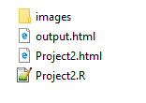
Introduction to project 2
Submission
The code file in Project2.R
The image folder will be named as images/ and please donot submit images
The report file with name Project2.md or Project2.html or Project2.docx
The output file in output*.html

Slide 10
Hierarchical Clustering
Henry Tu, 04-oct-2015

Slide 11
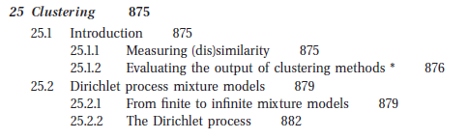
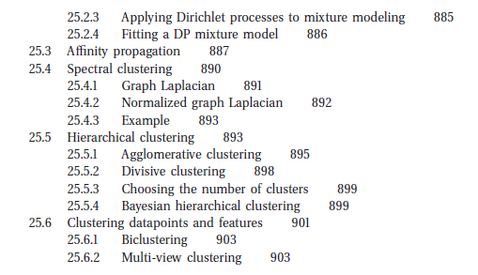
Hierarchical clustering
Spectral clustering
Dirichlet process
Infinite Mixture Model
Distance for clustering
Evaluating the clustering results

Slide 12
Clustering methods
https://en.wikipedia.org/wiki/Cluster_analysis
Hierarchical Clustering
Spectral clustering
Dirichlet process for clustering

Slide 13
Hierarchical Clustering

Slide 14
Merging / splitting
Merging: we start with n clusters for n samples; we then merge the nearest clusters to form larger
Splitting: we start from 1 cluster and we divide into two until we have n clusters

Slide 15
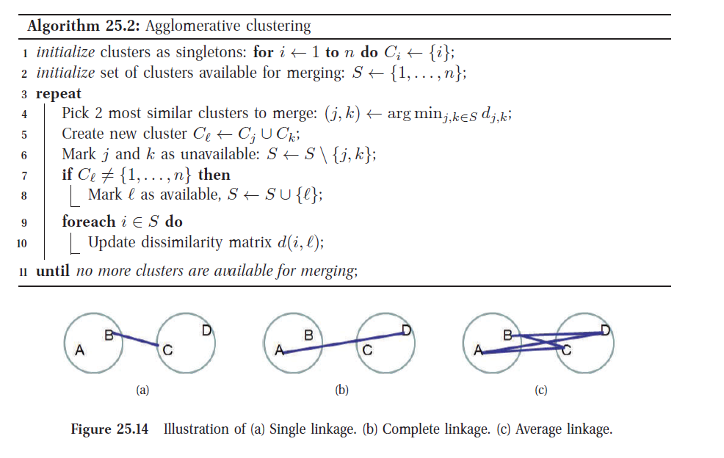

Slide 16
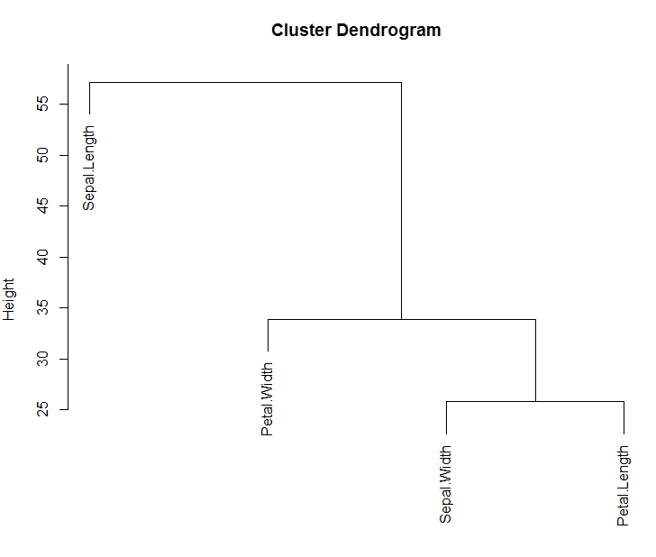
Practice in R
library(stats);
data(iris);
d <- dist( t(iris[, 1:4]) );
h = hclust(d, method="complete");
plot(h)

Slide 17
Distances
Single-linkage
Complete linkage

Slide 18
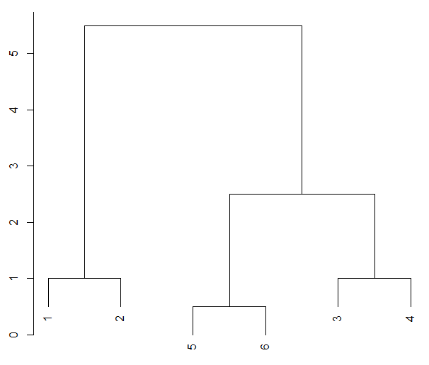
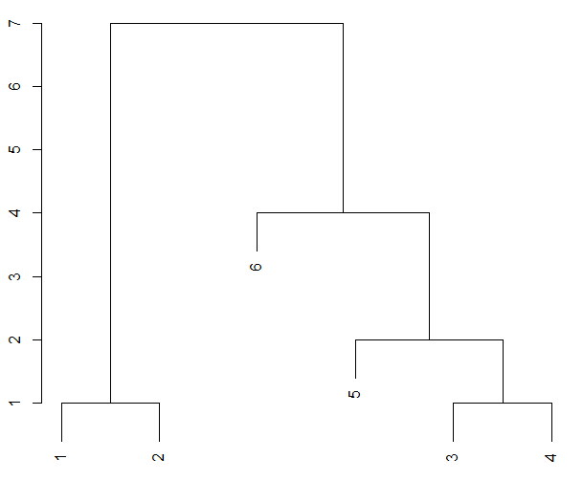
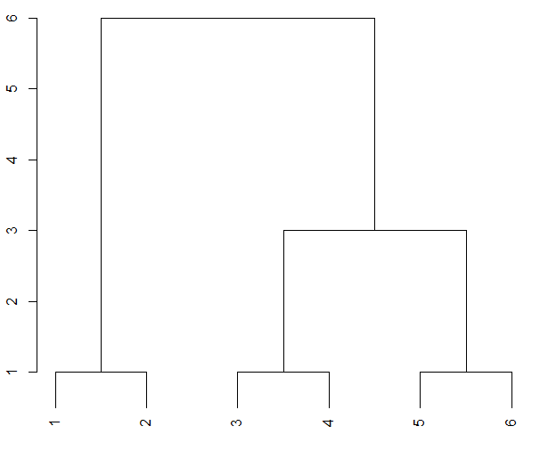
Complete
x <- cbind( c(1, 2, 4, 5, 6, 6.5) );
x <- cbind( c(1, 2, 4, 5, 6, 7) );
x <- cbind( c(1, 2, 4, 5, 6, 8) );

Slide 19
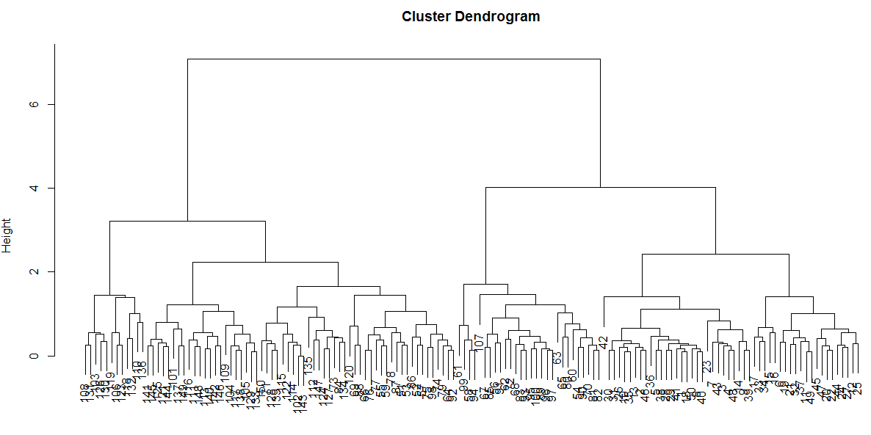
library(stats);
data(iris);
d <- dist( iris[, 1:4] );
h = hclust(d, method="complete");
plot(h)

Slide 20
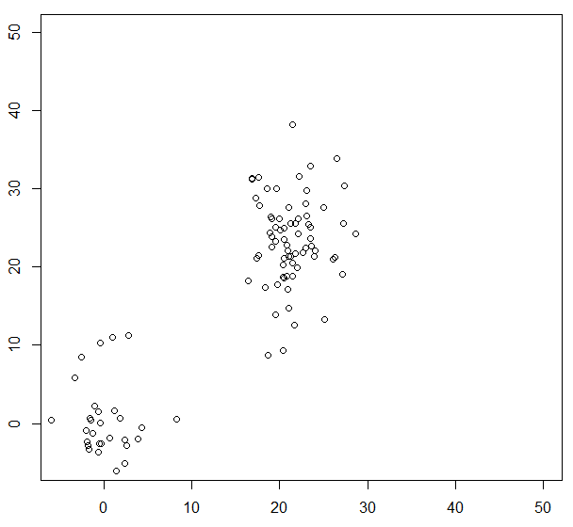
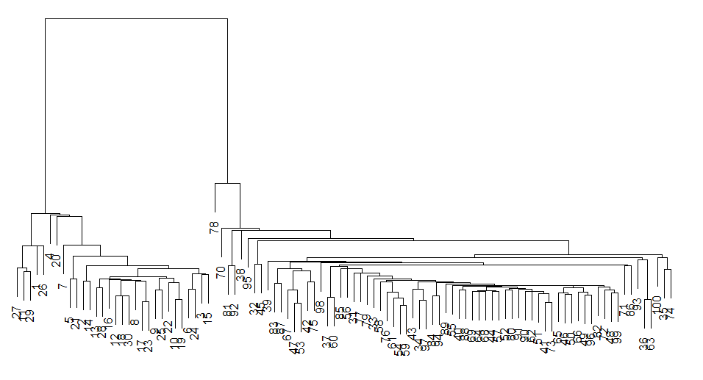
rm(list=ls()); graphics.off(); set.seed(1234);
load <- function()
{
x1 <- rnorm(30, 1, 1);
y1 <- rnorm(30, 3, 2);
x2 <- rnorm(70, 21, 1);
y2 <- rnorm(70, 23, 2);
x3 <- rnorm(70, 1, 1);
y3 <- rnorm(70, 23, 2);
df <- cbind(c(x1, x2, x3), c(y1, y2, y3) );
return(df);
}
df <- load();
plot(df, xlim=c(-5, 50), ylim=c(-5, 50) );
h = hclust(dist(df), method="complete");
dev.new(); plot(h);
labels <- cutree(h, k=3); # df <- cbind(df, labels); df
labels

Slide 21
Examples
Image clustering
Document clustering

Slide 22
Document vectoring
D <- list(
c("I", "love", "you"),
c("I", "love", "you", "love", "you"),
c("I", "love", "you", "I", "love", "you"),
c("they", "hate", "him"),
c("they", "hate", "him", "hate", "him", "hate", "him"),
c("they", "hate", "him", "they", "hate", "hate", "hate", "him")
);
wordHist <- function(D, V = c("I", "love", "you", "they", "hate", "him"))
{
H <- factor(D, labels=V, levels=V);
return( table(H) );
}
df <- t(sapply(D, wordHist) );

Slide 23
Spectral Clustering

Slide 24
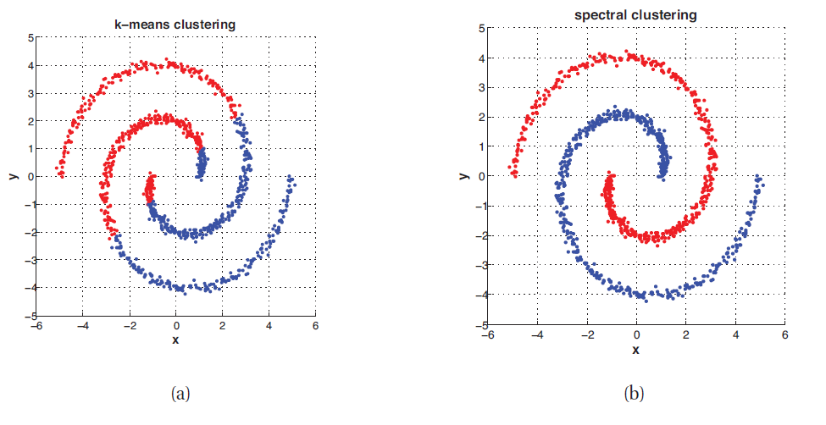

Slide 25
The method
The similar matrix A
The Laplacian matrix L
The eigenvectors of the matrix
And the clusters from eigenvectors/values

Slide 26
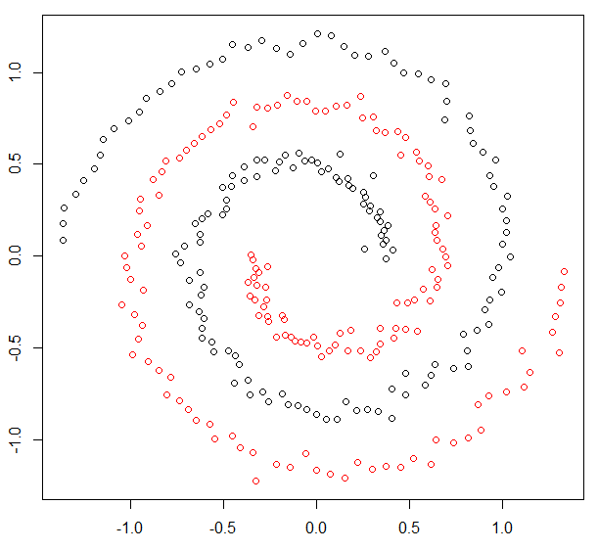
library(kernlab)
## Cluster the spirals data set.
data(spirals)
m <- specc(spirals, centers=2)
centers(m)
size(m)
withinss(m)
plot(spirals, col=m)

Slide 27
Summary 2
Markov model: the model, the learning method; the inference
Sampling methods
Sampling for optimization
Hierarchical clustering
Spectral clustering

